Slide 1
MACHINE LEARNING PROJECT ON DIABETES PREDICTION
- ROOPKATHA GANGULY

Slide 2
CONTENTS:
(A) WHY THIS TOPIC?
(B) BRIEF OF THE ENTIRE PROJECT(THE CODING AND PROCEEDURE):
(I) DESCRIPTION OF THE DATASET
(II) PRE-PROCESSING
(III) BRIEF DESCRIPTION OF THE ALGORITHMS USED AND THEIR OUTCOMES
(C) CONCLUSION
(D) FUTURE PROSPECT

Slide 3
WHY THIS TOPIC?
DIABETES IS A SERIOUS MEDICAL CONDITION THAT CAN CAUSE YOU TO BECOME FATIGUED, FEEL EXTREME HUNGER, AND EXPERIENCE OTHER MORE SERIOUS PROBLEMS OVER TIME. IF YOU DO NOT MANAGE THIS DISEASE, YOU COULD DEVELOP MORE SERIOUS COMPLICATIONS LIKE VISION PROBLEMS, DEMENTIA, AND KIDNEY ISSUES. IT'S IMPORTANT TO KEEP YOUR BLOOD SUGAR LEVELS IN YOUR TARGET RANGE AS MUCH AS POSSIBLE TO HELP PREVENT OR DELAY LONG-TERM, SERIOUS HEALTH PROBLEMS, SUCH AS HEART DISEASE, VISION LOSS, AND KIDNEY DISEASE. STAYING IN YOUR TARGET RANGE CAN ALSO HELP IMPROVE YOUR ENERGY AND MOOD
AND THAT’S THE SOLE REASON WHY THIS TOPIC HAS BEEN CHOSEN.
THROUGH THIS PEOPLE CAN GET A CLEAR IDEA ,WHETHER HE HAS DIABETES OR NOT AND CAN TAKE NECESSARY STEPS ACCORDINGLY.

Slide 4
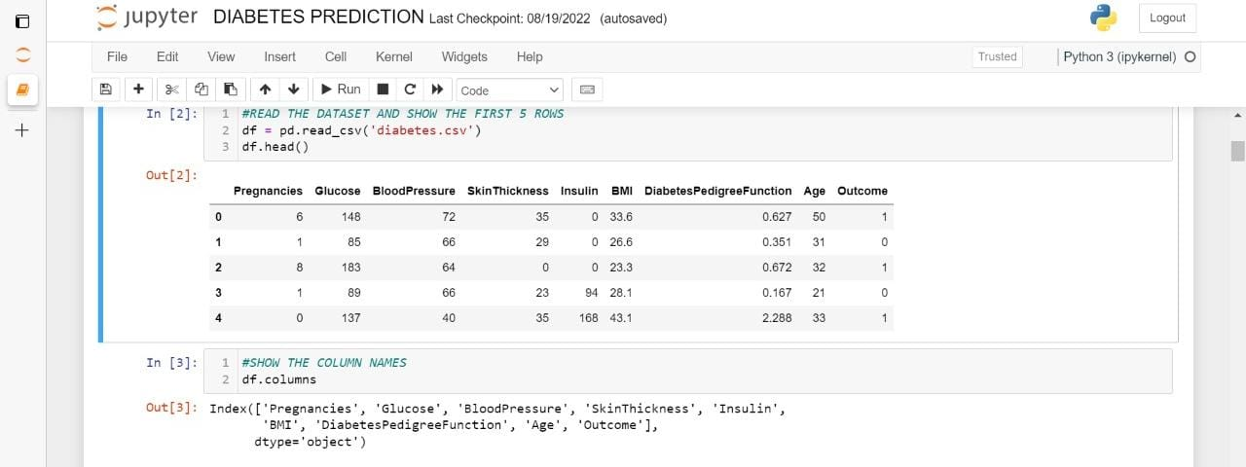
DESCRIPTION OF THE DATASET SOURCE: https://www.kaggle.com/datasets/mathchi/diabetes-data-set
THE DATA SET CONSISTS OF 9 COLUMNS,NAMELY:
PREGNANCIES
GLUCOSE
BLOOD PRESSURE
SKIN THICKNESS
INSULIN
BMI
DIABETES PEDIGREE FUNCTION
AGE
OUTCOME

Slide 5
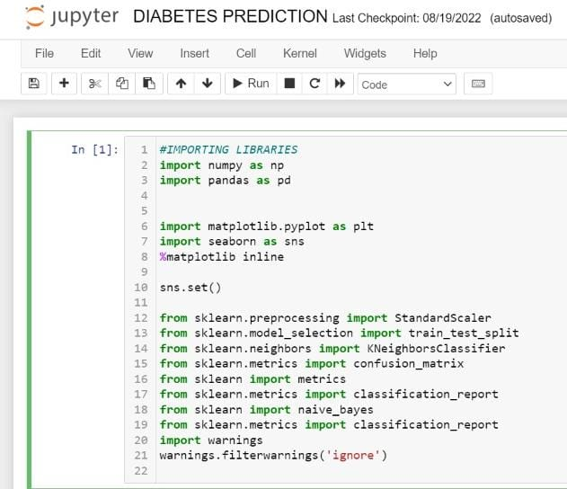
PRE-PROCESSING (BRIEF EXPLAINATION)
WE WORK IN THE JUPYTER NOTEBOOK ENVIRONMENT.
STEPS THAT WE FOLLOW:
IMPORTING BASIC LIBRARIES SUCH AS NUMPY,PANDAS,MATPLOTLIB,SEABORN
IMPORTING LIBRARIES FOR SCALARIZATION LIKE STANDARDSCALER
IMPORTING LIBRARIES FOR THE SPLITTING OF THE DATA FOR TRAINING AND TESTING SUCH AS TRAIN_TEST_SPLI
IMPORTING OTHER LIBRARIES TO ENSURE PROPER APPLICATION THE ALGORITHMS ON THE DATASET.
IMPORTING LIBRARIES LIKE CLASSIFICATION REPORT TO HELP US DRAW A CONCLUSION REGARDING THE FINAL ALGORITHM WE DECIDE TO GO WITH
THEN WE CHECK FOR ANY NULL VALUES AND IF WE HAVE THAT WE REPLACE THOSE NULL VALUES WITH THE MEDIAN OF THE OTHER VALUES IN THAT COLUMN.

Slide 6
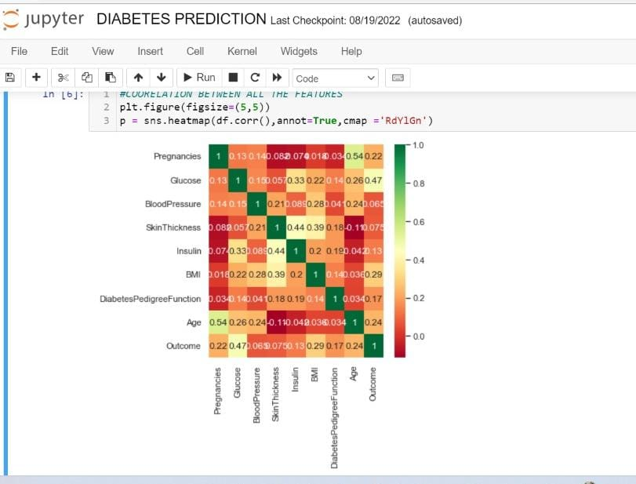
=> THEN WE GENERATE THE HEAT-MAP AND DRAW CONCLUSION REGARDING THE CORRELATION BETWEEN THE ELEMENTS.
=> NEXT WE SEPARATE THE OUTCOME COLUMN(THAT GIVES THE RESULT,0:NON-DIABETIC AND 1:DIABETIC) FROM THE REST OF THE COLUMNS
=> THEN WE GO FOR SCALARIZATION OF THE REST OF CLUMNS SUCH AS PREGNANCIES,BLOOD PRESSURE ETC SO THAT WE CHANGE THE VALUES OF NUMERIC COLUMNS IN THE DATASET TO USE A COMMON SCALE,WITHOUT DISTORTING DIFFERENCES IN THE RANGES OF VALUES OR LOSING INFORMATION.
=> FINALLY WE SPLIT THE DATASET (30% FOR TESTING AND 70% FOR TRAINING)
=> AND THEN WE PROCEED TO APPLY THE ALGORITHMS

Slide 7
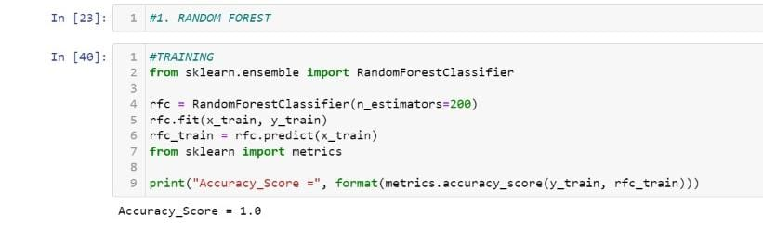
RANDOM FOREST CLASSIFICATION:
Random Forest is a popular machine learning algorithm that belongs to the supervised learning technique. It can be used for both Classification and Regression problems in ML. It is based on the concept of ensemble learning, which is a process of combining multiple classifiers to solve a complex problem and to improve the performance of the model. As the name suggests, "Random Forest is a classifier that contains a number of decision trees on various subsets of the given dataset and takes the average to improve the predictive accuracy of that dataset." Instead of relying on one decision tree, the random forest takes the prediction from each tree and based on the majority votes of predictions, and it predicts the final output. The greater number of trees in the forest leads to higher accuracy and prevents the problem of overfitting.
The Working process can be explained in the following steps:
Step-1: Select random K data points from the training set.
Step-2: Build the decision trees associated
with the selected data points (Subsets).
Step-3: Choose the number N for decision trees that you want to build.
Step-4: Repeat Step 1 & 2.
Step-5: For new data points, find the predictions of each decision tree
and assign the new data points to the category that wins the majority votes.

Slide 8
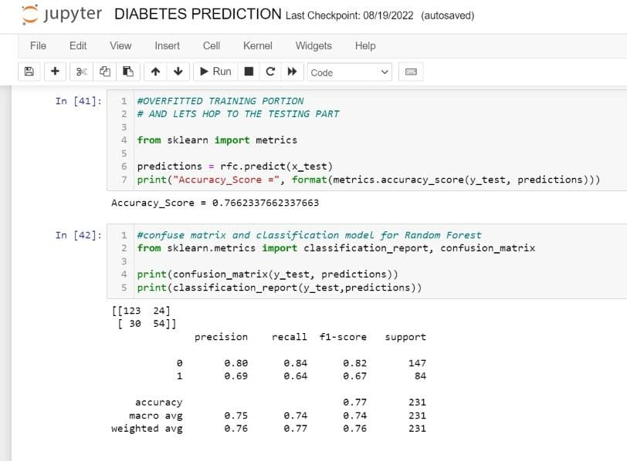
AFTER APPLYING RANDOM FOREST CLASSIFICATION ON OUR DATASET
WE OBTAIN AN ACCURACY OF ABOUT 76.623%
AND WE PRINT THE CONFUSION MATRIX THAT GIVES US A CLEAR IDEA ABOUT THE
=> F1 SCORE
=>RECALL
=>SUPPORT
=>PRECISION

Slide 9
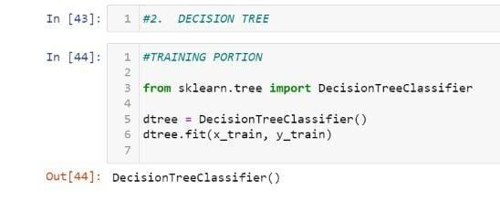
DECISION TREE
A decision tree is a flowchart-like structure in which each internal node represents a "test" on an attribute (e.g. whether a coin flip comes up heads or tails), each branch represents the outcome of the test, and each leaf node represents a class label (decision taken after computing all attributes). The paths from root to leaf represent classification rules. Decision Tree is the most powerful and popular tool for classification and prediction. A Decision tree is a flowchart-like tree structure, where each internal node denotes a test on an attribute, each branch represents an outcome of the test, and each leaf node (terminal node) holds a class label.
A general algorithm for a decision tree can be described as follows:
Pick the best attribute/feature. The best attribute is one which best splits or separates the data.
Ask the relevant question.
Follow the answer path.
Go to step 1 until you arrive to the answer.

Slide 10
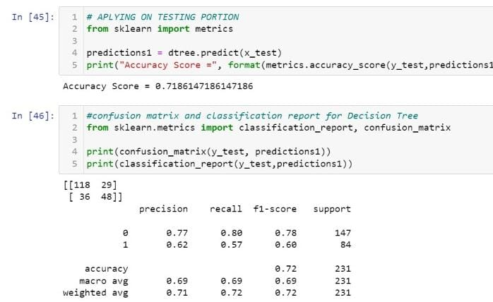
AFTER APPLYING DECISION TREE ON OUR DATASET
WE OBTAIN AN ACCURACY OF ABOUT 71.86%
AND WE PRINT THE CONFUSION MATRIX THAT GIVES US A CLEAR IDEA ABOUT THE
=> F1 SCORE
=>RECALL
=>SUPPORT
=>PRECISION

Slide 11
NAÏVE BAYES
Naive Bayes classifiers are a collection of classification algorithms based on Bayes’ Theorem. It is not a single algorithm but a family of algorithms where all of them share a common principle, i.e. every pair of features being classified is independent of each other.
Naïve Bayes algorithm is a supervised learning algorithm, which is based on Bayes theorem and used for solving classification problems..
Naïve Bayes Classifier is one of the simple and most effective Classification algorithms which helps in building the fast machine learning models that can make quick predictions.
It is a probabilistic classifier, which means it predicts on the basis of the probability of an object.
Naïve: It is called Naïve because it assumes that the occurrence of a certain feature is independent of the occurrence of other features. Such as if the fruit is identified on the bases of color, shape, and taste, then red, spherical, and sweet fruit is recognized as an apple. Hence each feature individually contributes to identify that it is an apple without depending on each other.
Bayes: It is called Bayes because it depends on the principle of Baye’s Theorem

Slide 12
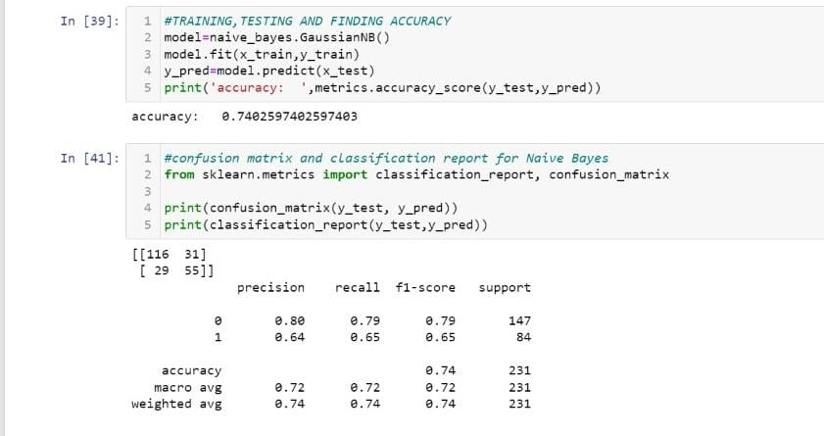
AFTER APPLYING NAÏVE BAYES ON OUR DATASET
WE OBTAIN AN ACCURACY OF ABOUT 74.02%
AND WE PRINT THE CONFUSION MATRIX THAT GIVES US A CLEAR IDEA ABOUT THE
=> F1 SCORE
=>RECALL
=>SUPPORT
=>PRECISION

Slide 13
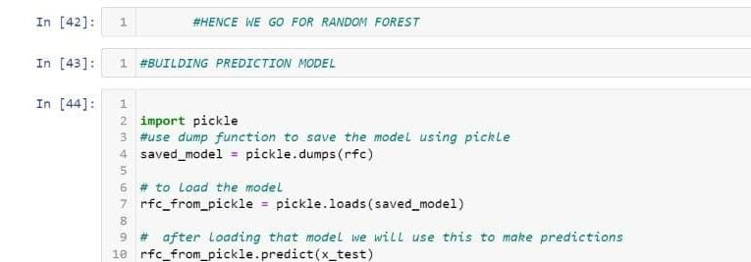
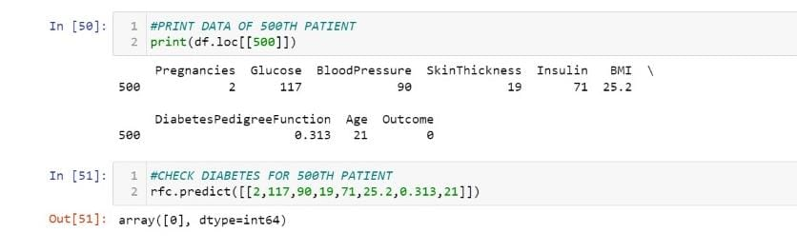
CONCLUSION:
AFTER APPLYING ALL THE ALGORITHMS WE COME TO THE CONCLUSION THAT RANDOM FOREST ALGORITHM GAVE US THE HIGHEST ACCURACY AND WORKS BEST IN OUR CASE.
HENCE WE BUILD A PREDICTIVE MODEL BY USING THE RANDOM FOREST CLASSIFIER AND WE GET THE CORRECT RESULT SO FAR.

Slide 14
FUTURE PROSPECT
10.5% of the U.S. population had diabetes, according to the Centers for Disease Control and Prevention's National Diabetes Statistics Report, 2020. If this number continues to grow at the same rate, by 2040, it is predicted that diabetes will affect 642 million people globally.
Since there is no cure to the disease, all we can do is identify whether the person has the disease or not and control it and monitor it regularly to ensure proper health of the person
Hence,this project can help in identification of the disease because its utmost necessary to know whether a person has diabetes or not because its one of the most common issues people are ignorant about.

